Slide 1

Air Travel
Competive analysis of leading travel aggregators
Notes:
Air travel is an exotic endeavor. Advertisements often promote the appeal of travelling to a different location for a holiday. With the advent of low airfares in the 1980s, more and more individuals have taken the opportunity to see parts of the world that were previously out of reach. Recent events and their promotion in the newspapers, though, raise the possibility that individuals may be at some harm from air travel. Several case reports exist, for example, that note a medical emergency occurring during a flight. What are the health risks associated with air travel? This lecture discusses the current understanding regarding these risks.
The author, Thomas Songer, is an assistant professor in the Department of Epidemiology, Graduate School of Public Health, University of Pittsburgh. He is a member of the Center for Injury Research and Control at the University of Pittsburgh and is an irregular airline flyer.
Related Internet Links:
-Air Travel and Health. House of Lords, Select Committee on Science and Technology Fifth Report. (http://www.parliament.the-stationery-office.co.uk/pa/ld199900/ldselect/ldsctech/121/12101.htm)
-Health Physics; November 2000 issue, abstracts online (http://www.health-physics.com/)
-CDC links on Air Travel and Health (http://www.cdc.gov/travel/cruiships.htm)

Slide 2
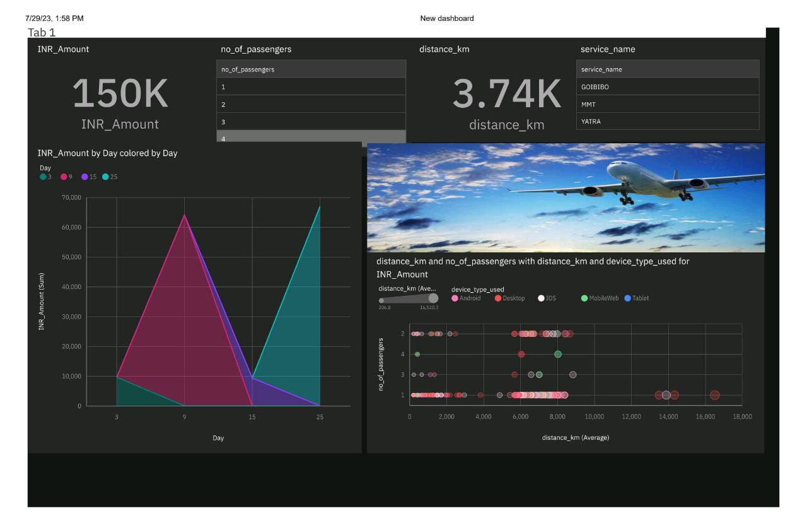

Slide 3
Learning Objectives
To introduce the possible health risks associated with air travel in the short- and long-term.
To understand the primary issues related to deep vein thrombosis and air travel.
To identify the study design issues underlying research on the health effects of exposure to cosmic radiation.

Slide 4


“Fasten your seat belts - it could be a sickly ride” .. Mail on Sunday July 2000
“Long flights cost 2000 lives a year” ..Telegraph Jan 2001
“Flying can prove fatal in economy class” ..Independent on Sunday May 2000
“Long haul passengers pass out from oxygen shortage” ..Sunday Times 5/2000
Notes:
This lecture originated from a serious of newspaper headlines in the British newspapers. If you are a fan of these newspapers, then you might recall the headlines illustrated here; all of which were published within a very short period of time.
What is your reaction after reading these accounts? Perhaps, you might be a little more leery of flying. Perhaps, you were unaware of health events related to flying. Have the papers portrayed the correct message? The fact is that we currently have a limited understanding of the size of health risk related to air travel.

Slide 5


Health vs. Safety
Notes:
There are two issues of relevance in the discussion of the potential risks of air travel; the association between health and air travel and that between safety and air travel. This lecture will detail the current discussions regarding health and air travel. A second lecture regarding safety is available on the Epidemiology Supercourse web site.
See: Air Safety and Terrorism (http://www.pitt.edu/~super1/lecture/lec4811/index.htm)

Slide 6

What health risks are associated with air travel?

Slide 7
Potential Health Risks
From Acute Exposures
  Deep Vein Thrombosis
  Infection
  Injury
  Adverse events in the medically vulnerable
Notes:
Several short-term health effects of air travel are postulated in the literature. These include the recent events publicized regarding deep vein thrombosis on long haul flights, concern over the transmission of infectious agents in cabin air, foodbourne outbreaks on aircraft, injuries from failing luggage in overhead bins, and the onset of disease endpoints in persons with pre-existing disease. One common example is the development of acute myocardial infarctions (thought to be brought on by the environment of the airliner).
There recently has been some concern over the transmission of tuberculosis from an infected passenger to others on the airplane, or the spread of tuberculosis from endemic areas due to the increased availability of air travel throughout the world. Case reports of infectious individuals traveling on planes and exposing passengers to TB are published. A recent review, though, suggests that transmission to other passengers is not always certain, and no case of active TB has been thought to result from exposure while in air travel.
See: WHO, Tuberculosis and Air Travel: Guidelines for Prevention and Control. (http://www.who.int/gtb/publications/aircraft/contents.html)

Slide 8
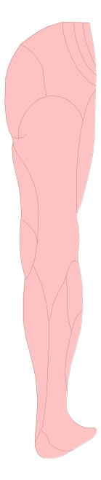
Deep Vein Thrombosis
a thrombus (blood clot) within a deep vein, commonly in the thigh or calf
may develop in a narrowed or blocked vein, which allows the blood to clot
the most serious complication of DVT is a pulmonary embolism
Notes:
The health effect of most recent concern, though, is the development of a deep vein thrombosis (a blood clot in a deep vein of the thigh or calf) after long flights. Deep vein thrombosis is a common medical condition in the general population. It can be caused by a narrowed or blocked vein which increases the risk for clotting.
The complication of urgent concern with deep vein thrombosis is the onset of a pulmonary embolism, brought on by the blot clot traveling from the leg vein to the lung (where it subsequently blocks an artery). Many of the recent deaths from air travel have been through a pulmonary embolus.
See: Deep Vein Thrombosis. British United Provident Association (BUPA). (http://hcd2.bupa.co.uk/fact_sheets/mosby_factsheets/Deep_Vein_Thrombosis.html)

Slide 9
Deep Vein Thrombosis
Can be brought on by
  an injury to the vein, or following surgery
  poor circulation from inactivity
  pregnancy
  severe infection
  liver disease
Notes:
Known factors or characteristics that may lead to the development of a deep vein thrombosis are an injury to the leg, recent surgery, poor circulation, pregnancy, infections liver disease and some cancers.
Source: BUPA

Slide 10
Deep Vein Thrombosis
Symptoms
  tenderness/redness in affected area
  pain & swelling in affected area
  fever
  rapid heart beat
  joint pain and soreness
Notes:
Typical symptoms of deep vein thrombosis are shown here.

Slide 11
Risk Factors for DVT
Increasing Age (above 40 years)
Pregnancy
Previous or Family history of DVT
Clotting disorders
Recent major surgery
Estrogen hormone therapy & OCs
Immobility
Gender
Notes:
One recent study of DVT in non-hospitalized patients found several potential risk factors, including increasing age (higher in the elderly), recent surgery, more than 3 pregnancies, previous DVT, and estrogen use (either as hormone replacement therapy or as oral contraceptives). Immobility has also be hypothesized as a leading factor for the development of clots.
See: Meyer-Michel Samama, MD(BiolPharm); for the Sirius Study Group
Arch Intern Med. 2000;160:3415-3420

Slide 12

Economy Class Syndrome??
Notes:
Deep vein thrombosis related to air travel has often been referred to as “economy class syndrome” in the past. This term came about because of the thought that the cramped seating of economy class led to the development of DVT.

Slide 13
DVT and Long Haul Travel
Increasing Age
Increasing Duration of Travel
Immobility
Seating Constraints and Posture
Cabin Environment (low humidity)
Excessive alcohol and/or caffeine
Obesity?
Height?
Notes:
Hypothesized risk factors for the development of DVT in air travel include long periods of immobility (most often seen on long flights), dehydration, and seating, as well as the risk factors observed for DVT in general. There is some conjecture that height (over six feet or under five feet) may be a factor because of the design of airline seats.
See: DVT facts (http://www.aviation-health.org/dvtfacts.html)

Slide 14
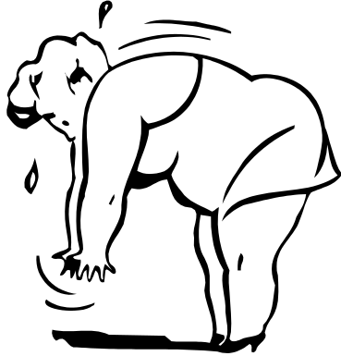
Changing Demographics of Air Travel
Aircraft seats designed for persons who average 5’7’’ and 170 lbs.
More vulnerable passengers are now able to fly from an economic perspective
Projected increase in air travel
Notes:
Airline seats, themselves, may not accommodate the comfort of all passengers. Most are typically designed for average sized persons. However, it is common knowledge that obesity is quite prevalent in the developed world. Moreover, the increased accessibility to air travel (through cheaper fares) brings potentially more medically vulnerable passengers onto planes today than in the past.

Slide 15
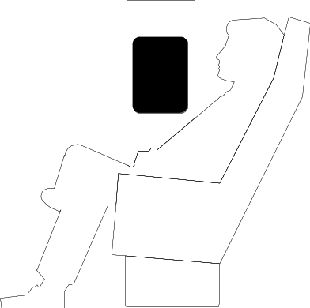
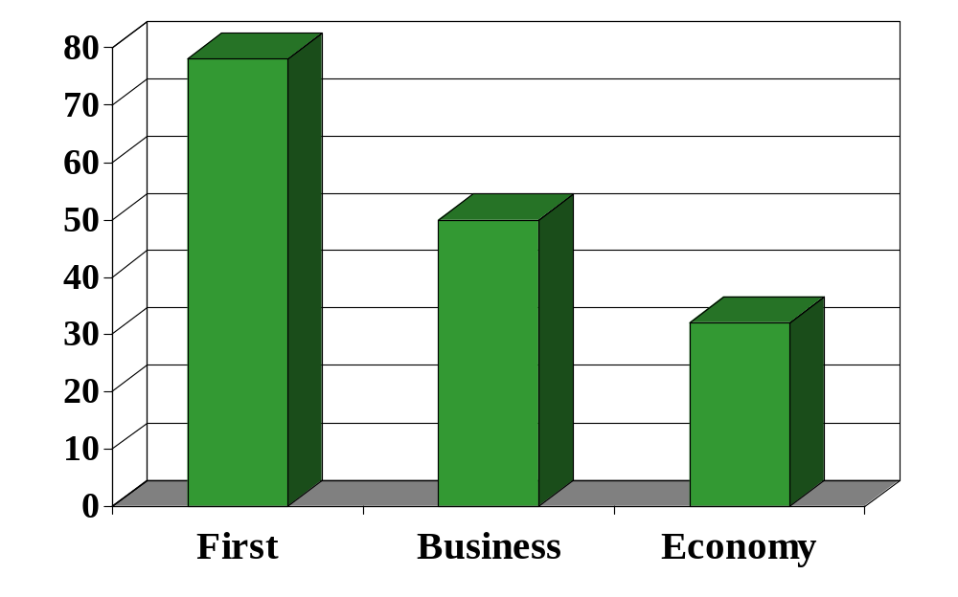
Airline Seat Pitch
inches
Skytrax
Notes:
The notion of DVT being an economy class phenomenon is brought out by the statistics regarding the seating comfort of economy class. Seating pitch (the distance between seats) is lowest in economy class.
Source: Skytrax (http://www.airlinequality.com/Product/seat_intro.htm)

Slide 16
Airline Seat pitch
Air France 31
British Airways 31
American Airlines 33
Lufthansa 31
Northwest/KLM 31
Swissair 32
United 31
Notes:
Economy class seating pitch is fairly standard across airlines. Increasing seat pitch leads to fewer seats on a plane, and potentially lower revenue per passenger mile.
Source: Skytrax (http://www.airlinequality.com/Product/seat_intro.htm)

Slide 17
Recent DVT episodes
-a 42 year old woman died following a 9 hour flight from SF to London. She was seated in business class.
-a 45 year old CEO suffered a DVT on a flight from NY to Geneva. He was seated in first class.
Notes:
Not all of the recent events of DVT and pulmonary emboli in air travel, though, have involved economy class.

Slide 18
Epidemiology of DVT from
Air Travel
Notes:
While there is a lot of conjecture regarding the risk of DVT and pulmonary embolism from air travel, there is remarkably little scientific evidence to quantify what the level of risk might be or if there even is an association between air travel and DVT.
The British government has recently commented on the the lack of data on DVT and air flight. At issue is if the number of persons developing DVT after flying is markedly higher than the number expected to develop DVT (without exposure to flying). The WHO, and the British, and Australian governments have called for new studies in this area.
See: House of Lords, Select Committee on Science and Technology Fifth Report. (http://www.parliament.the-stationery-office.co.uk/pa/ld199900/ldselect/ldsctech/121/12101.htm)

Slide 19
Travel as a risk factor for venous thromboembolic disease
VTED
Control
p-value
Age (years)
65.3
66.0
n.s.
Hypertension (%)
11.8
18.1
n.s
Sex (% male)
51.8
66.2
0.04
VTED history (%)
11.8
4.4
0.02
Obesity (%)
33.7
20.0
0.01
Recent travel (%)
24.4
7.5
<0.001
Ferrari 1999
Notes:
Three recent case-control studies provide conflicting results on the possible association between air travel and venous thromboembolic disease. A report by Ferrari, et al, shown here, suggests a higher percentage of air and train travel among persons with DVT and emboli (cases) and those without it (controls).
See: Ferrari E, Chevallier T, Chapelier A, Baudouy M. Travel as a risk factor for venous thromboembolic disease; a case-control study. Chest 115(2):440-444, 1999.

Slide 20
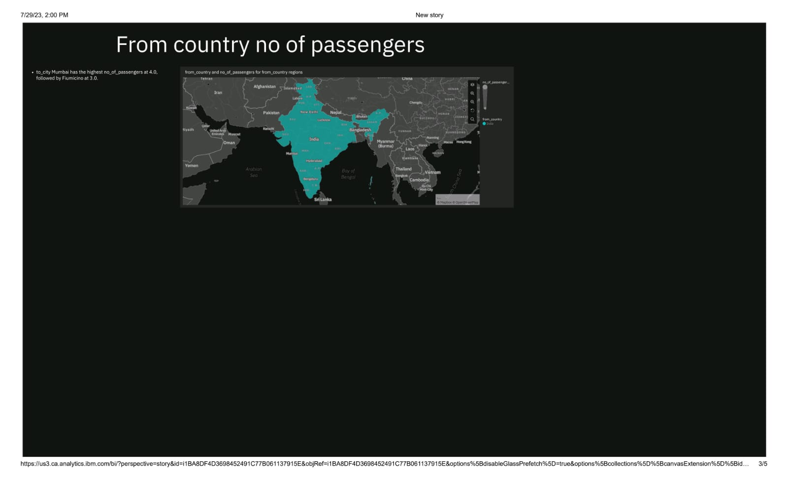

Slide 21
Travel and risk of venous thrombosis
Odds
Ratio
Cases Controls
Plane Travel 4% 13%
1.0
(0.3 - 1.4)
Kraaijenhagen 2000
Notes:
Another report by Kraaijenhagen found the opposite finding. Further the two latest reports are also conflicting. Samana reports a higher rate of travel in those with DVT (Odds ratio: 2.35 (1.45-3.8)) compared to those without DVT, while Arya reports an odds ratio of 1.3 (0.6-2.8).
See: Kraaijenhagen RA, Haverkamp D, Koopman MMW, Prandoni P, Piovelta F, Buller HR. Travel and risk of venous thrombosis. Lancet 356:1492-93, 2000.
Samama MM. An epidemiologic study of risk factors for DVT in medical outpatients; the Sirius study. Arch Int Med 160:3415-20, 2000.
Arya R, Barnes JA, Hossain U, Patel RK, Cohen AT. Long-haul flights and deep vein thrombosis: a significant risk only when additional factors are also present. Brit J Haematology 116:653-54, 2002.

Slide 22
Current Knowledge
The link between air travel and DVT is not clear
“There is a link between flying and the development of blood clots, but I think the problem is still quite small, and that it is a relatively small number of passengers who are at risk”
John Scurr
Notes:
Thus, the association between DVT and air travel is under some dispute, and the level of risk, if significant, appears to be small.
See: Hirsch J, O’Donnell MJ. Venous thromboembolism after long flights: are airlines to blame? Lancet 357: 1461-62, May 12 2001.

Slide 23


Potential Health Risks
From Chronic Exposures
  cancers/leukemia from
    cosmic radiation
    cabin air exposures
Notes:
Long-term health effects of air travel are another issue of interest. It is postulated, for example, that chronic exposures to cosmic radiation or second-hand smoke in the air cabin increase the risk for certain cancers and leukemia in air crew. The attention being given to these chronic effects, though, is not nearly as high as that afforded the acute effects (namely DVT).

Slide 24
Cosmic Radiation
Doses are affected by ….
Altitude
Latitude
Solar Activity
Kendall 2000
Notes:
The effects of exposure to cosmic radiation are of most interest at the moment (as most airlines have prohibited smoking on flights). Evidence indicates that pilots and flight attendants are exposed to higher levels of cosmic radiation than the general population. The underlying rationale is that cosmic radiation increases as one gets higher in the atmosphere, is greater over polar regions than the equator, and is greater during periods of heightened sun flares.
See: Kendall G. Factors Affecting Cosmic-Ray Doses at Aircraft Altitudes. Health Physics 79:560-562, 2000.

Slide 25

Atmospheric depths Aircraft heights (km)
(g cm ⁻²)
25
30
Private jet (15 km)
20
SST (18-20 km)
100
15
10
300
Commercial (10 km)
5
1000
Tibet (3.7 km)
Kendall 2000
Notes:
Exposure to cosmic radiation may also vary by the type of aircraft flown. Different aircraft tend to fly at different levels in the sky. Most major airline jetliners fly at close to 30-33,000 feet. Smaller planes fly at lower altitudes. Conversely, supersonic transport, including the Concorde, fly at higher altitudes. This illustrates that studies of the health effects of cosmic radiation should also consider exposure levels by identifying the types of aircraft flown.

Slide 26
Radiation Exposure in Flight
1E-07
70
35-36,000 ft.
38,000 ft.
60
8E-08
50
6E-08
dose (Grays/min)
40
cumulative dose equiv. (uSv)
30
4E-08
20
2E-08
10
0
1
2
3
4
5
6
7
8
9
Seattle
Flight time (hours)
Tokyo
Notes:
This slide provides an illustration of the variance in cosmic radiation associated with air travel. The graph notes the absorbed dose of radiation at different points in time on a flight from Seattle to Tokyo on board a 747-200 aircraft. The solid red line (increasing) notes the cumulative dose during the time of the flight.
At the start of the flight, there are extremely small levels of absorbed dose. This reflects the plane on the ground in Seattle. Note the sharp increase as the plane rises to flight altitude quite quickly after takeoff (within 30 minutes). Later in the flight an other increase in absorbed dose (green line) is observed. This likely reflects the plane travelling over the polar regions on the trip to Tokyo, as well as higher altitude levels. The descent into Tokyo appears measured.
In Waters M, Bloom TF, Grajewski B. The NIOSH/FAA Working Women’s Health Study: Evaluation of the Cosmic Radiation Exposures of Flight Attendants Health Physics 79(5):553-559, November 2000

Slide 27
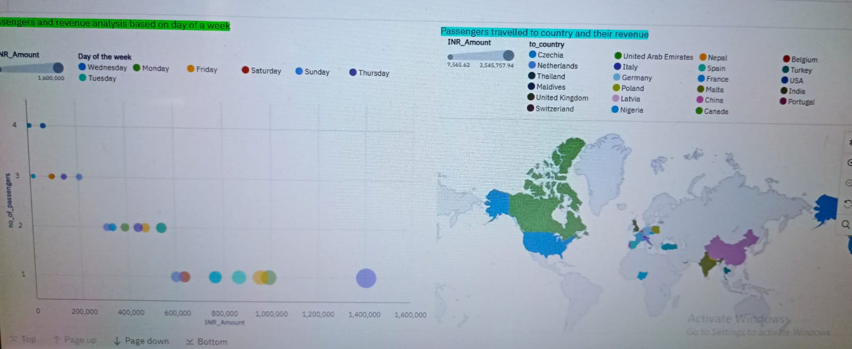

Slide 28
Annual Dose
Air Crew 0.2 - 5.0 mSv
General Population 1.1 mSv
Waters 2000
Notes:
Annual exposures to cosmic radiation are higher in flight crews and pilots. What this means with respect to long-term health and what policies might be appropriate are two important questions under debate. Views on the effects of cosmic radiation and appropriate policies appear to differ between the US and Europe.
See: Health Physics November 2000 issue

Slide 29
Leukemia/Cancer in Cockpit Crew
Danish cockpit crew members known to aviation medicine clinic (1946-present)
Flight hours, aircraft, certification data gathered
Danish Cancer Registry
National Death Index
Notes:
Increased exposure to cosmic radiation in flight crew gives concern of health effects primarily in two domains; pregnancy and the development of cancers. Epidemiologic studies of the impact of long-term exposure to cosmic radiation must deal with several underlying issues. First, the measurement of exposure to radiation may be difficult. Estimates of exposure, though, have been gathered from flight records and details regarding the type of aircraft flown. Levels of exposure, over time, though, may be low and require large numbers of participants to achieve appropriate statistical power. Third, there are questions about what an appropriate control group might be. Selection bias into flight occupations may influence the study, for example.
This slide illustrates one recent study of cancers in cockpit crew members in Denmark. Data were gathered from an airline medical clinic over time and matched to flight records, cancer registry data, and death data.
See: Boice JK, Blettner M, Auvinen A. Epidemiologic Studies of Pilots and Aircrew. Health Physics 79(5):576-584, 2000.
Gundestrup M, Storm HH. Radiation-induced acute myeloid luekemia and other cancers in commercial jet cockpit crew: a population-based cohort study. Lancet 354:2029-31, 1999.

Slide 30
Leukemia/Cancer in Cockpit Crew
Standardised Incidence Ratios
Cancer <1000 1K-5K >5000
Leukemia 0 0 1.9
AML 0 0 5.1
CLL 0 0 1.3
Melanoma 0 0 2.8
Other Skin 0 0 3.0
Gundestrup 1999
Notes:
Increased incidence ratios of cancer and leukemia were only observed in cockpit crew members flying more than 5000 hours. Significantly increased ratios were observed for acute myeloid leukemia, melanoma, and other skin cancers. Do you think that the melanoma and skin cancers are related to cosmic radiation or some other factor? Many postulate that these cancers may be related to higher sun exposures among the crew compared to the general population.
Overall, there appears to be inconsistent evidence of a link between cancer and cosmic radiation.

Slide 31
The information reviewed suggests that ..
The short-term and long-term health hazards of air travel are of interest
There is little scientific evidence to quantify the association between air travel and DVT
There is inconsistent evidence of a link between cancer and cosmic radiation

